Slide 1
Week2_DAO

Slide 2
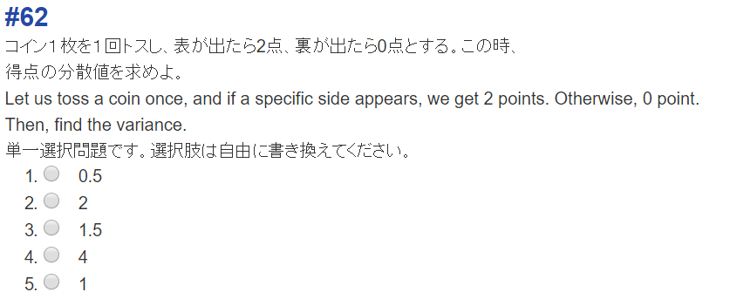

X | 2 | 0
P | ½ | 1/2

Slide 3

X² | 2² | 0
P | ½ | 1/2

Slide 4
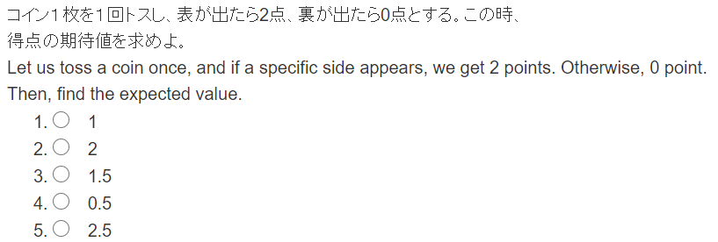

Slide 5
X | 2 | 0
P | ½ | 1/2

